Slide 1
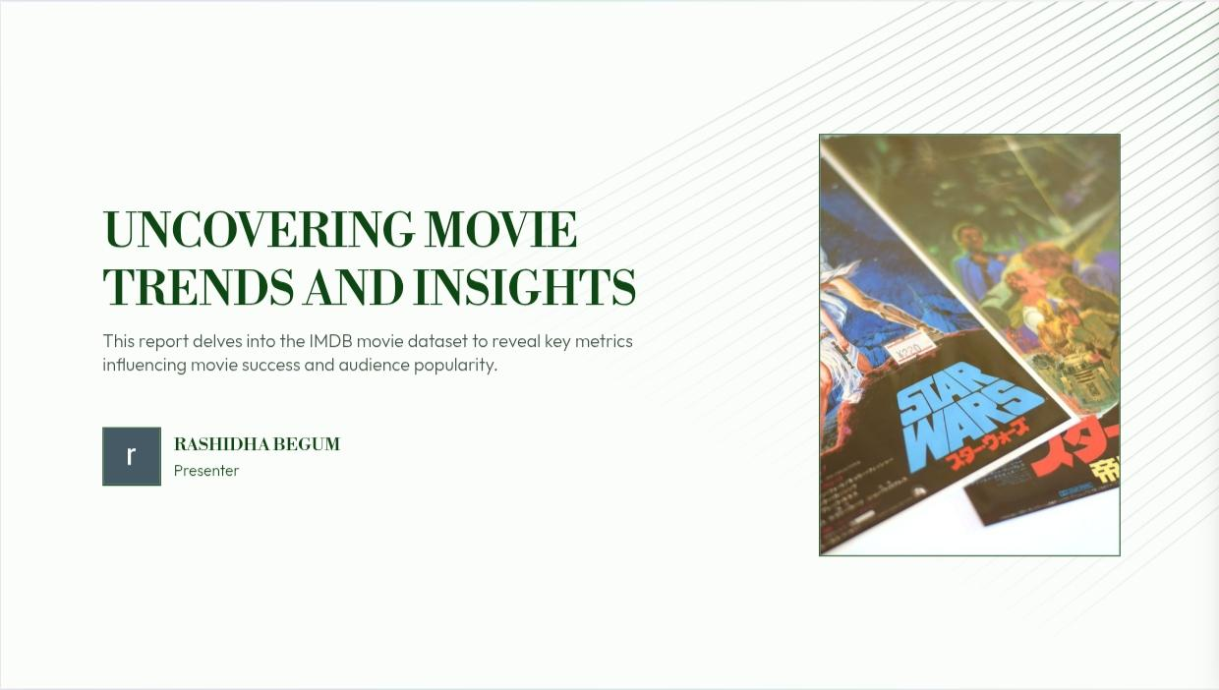

Slide 2
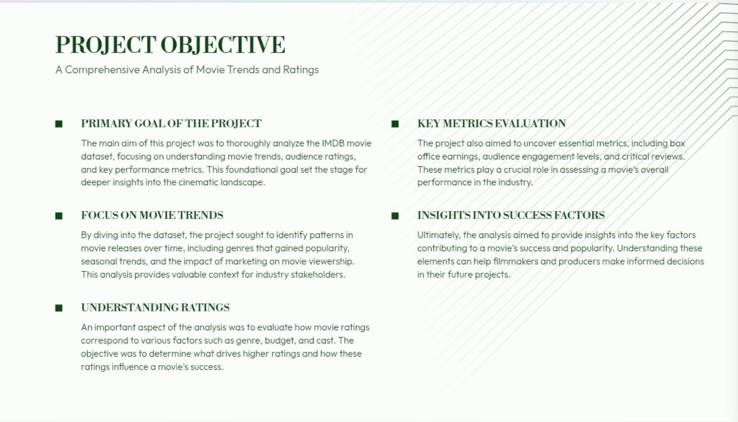

Slide 3
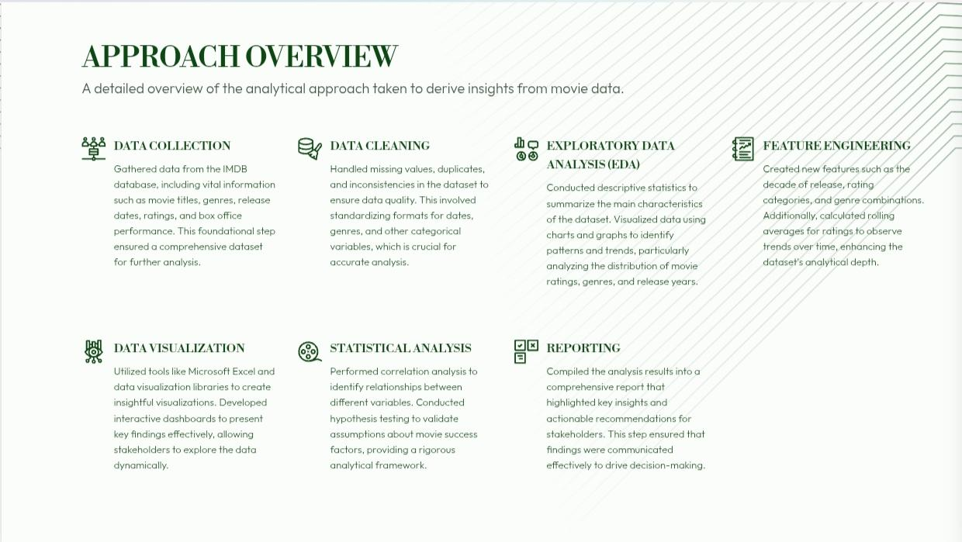

Slide 4
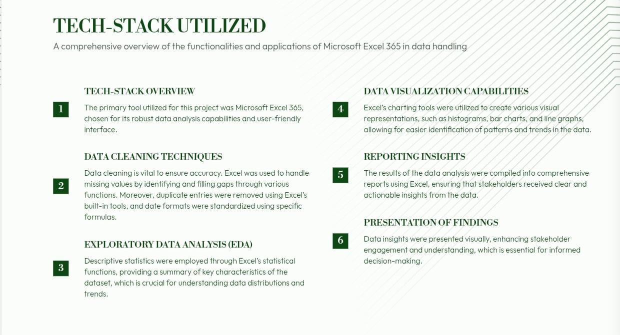

Slide 5
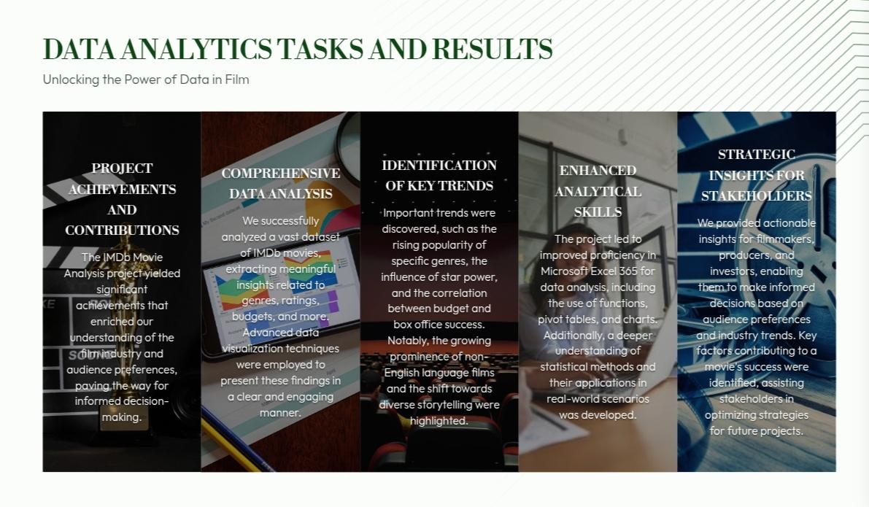

Slide 6

Movie Genre Analysis
A Comprehensive Overview of Movie Ratings by Genre
Mean IMDB Score:
7.2
THE AVERAGE IMDB SCORE INDICATES OVERALL MOVIE QUALITY.
An average IMDB score of 7.2 suggests that the majority of movies in the dataset are well-received by audiences, reflecting positively on production quality and storytelling.
Median IMDB Score:
7.5
THE MEDIAN SCORE HIGHLIGHTS THE CENTRAL TENDENCY OF MOVIE RATINGS.
The median score of 7.5 indicates that half of the movies scored above this value, suggesting a strong performance in the industry.
Mode IMDB Score: 8
THE MOST FREQUENTLY OCCURRING SCORE REFLECTS POPULAR MOVIE QUALITY.
With an IMDB score of 8.0 being the mode, it shows that many movies hit this sweet spot, appealing to a broad audience.
Range: 4.0 - 9.5
THE RANGE INDICATES DIVERSITY IN MOVIE QUALITY.
A score range from 4.0 to 9.5 highlights the variety of movie quality, from poorly rated films to critically acclaimed masterpieces.
Variance: 1.2
VARIANCE INDICATES CONSISTENCY IN MOVIE RATINGS.
A variance of 1.2 suggests that there is moderate variability in the IMDB scores, indicating a mix of both highly rated and lower-rated movies.

Slide 7
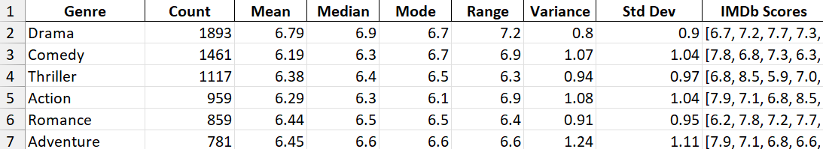

Slide 8
FUNCTIONS
= COUNT(Z2:Z7)
MEAN
= AVERAGE (Z2:Z7)
MEDIAN
=MEDIAN(Z2:Z7)
MODE
=MODE(Z2:Z7)
RANGE
= MAX(Z2:Z7) – MIN(Z2:Z7)
VARIANCE
=VAR.S(Z2:Z7)
Std.Dev
=STDEV.S(Z2:Z7)
= QUARTILE (A1: A10,1) MINIMUM
=QUARTILE(A1:A10,2) MEDIAN
=QUARTILE(A1: A10,3) MAXIMUM
=PERCENTILE.INC (A1:A20,0.25)
=PERCENTILE.INC(A1:A20,0.75)
=PERCENTILE.INC(A1:A20,0.987)
=MAX(D2: D10)
=CORREL(A2:A101,B2:B101)

Slide 9
MOVIE DURATION ANALYSIS
Correlation between Movie Duration and IMDB score
37 MINUTES
96 MINUTES
106 MINUTES
SHORTEST MOVIE DURATION
MEDIAN MOVIE DURATION
1ST QUARTILE DURATION
shortest movie duration recorded is 37 minutes, indicating that film lengths can vary significantly, which may attract different audience segments based on their time availability.
25% of movies have a duration of 96 minutes or less, suggesting that a significant portion of films target a concise storytelling format that can maintain viewer engagement.
The median movie duration is 106 minutes, reflecting a common length for films that balances storytelling depth with audience attention spans.
120 MINUTES
330 MINUTES
0.37
3RD QUARTILE DURATION
CORRELATION COEFFICIENT
LONGEST MOVIE DURATION
75% of movies have a duration of 120 minutes or less, indicating that the majority of films are crafted to fit a standard feature film runtime that resonates well with audiences
Longest movie duration is 330 minutes, showcasing the existence of epics and extended storytelling that may cater to niche audiences seeking comprehensive narratives.
correlation coefficient between duration and IMDB score is 0.366, suggesting a moderate positive relationship where longer films may tend to receive higher scores, informing production strategies around runtime.

Slide 10
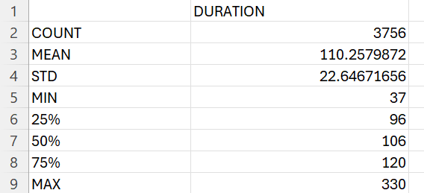

Slide 11
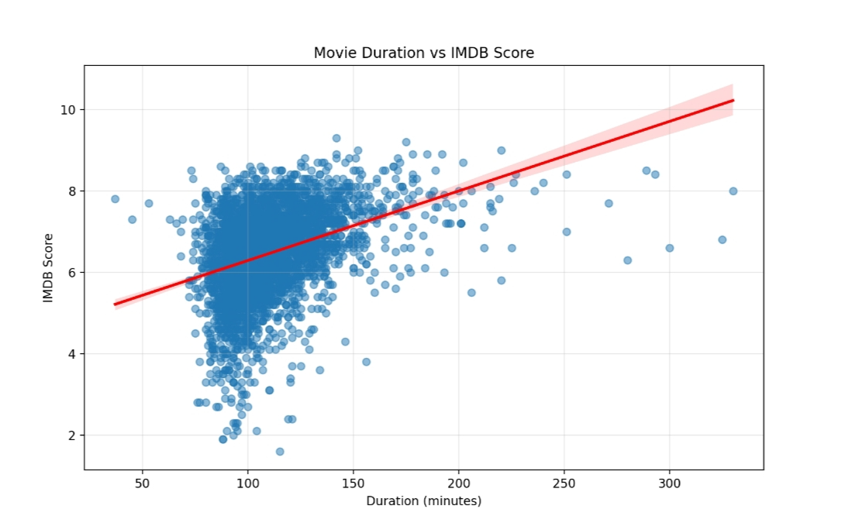

Slide 12
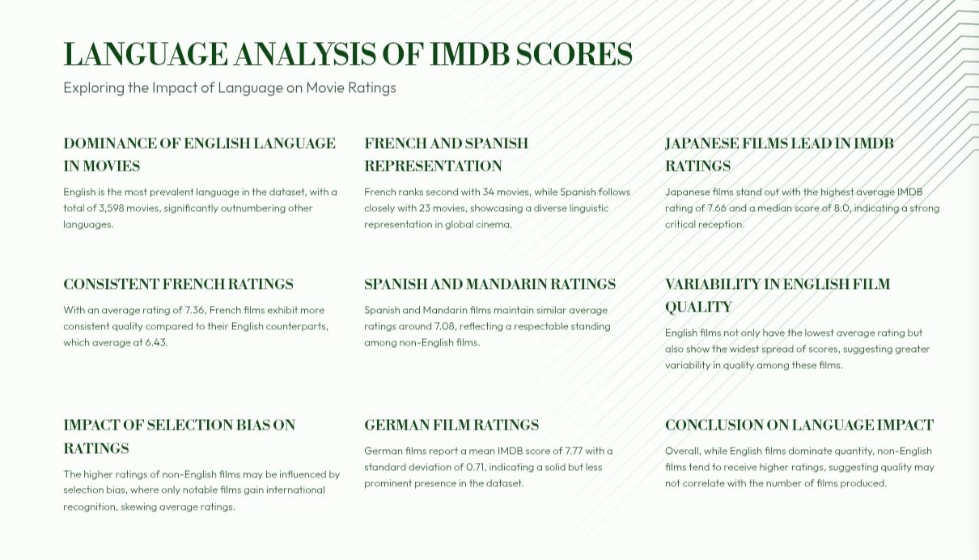

Slide 13
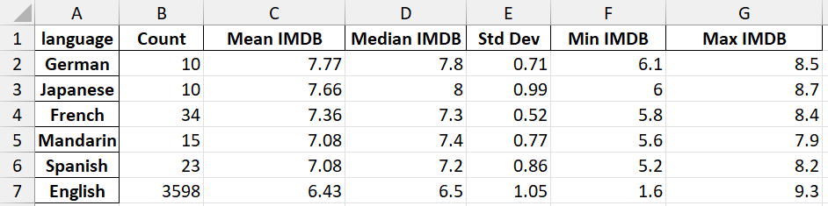
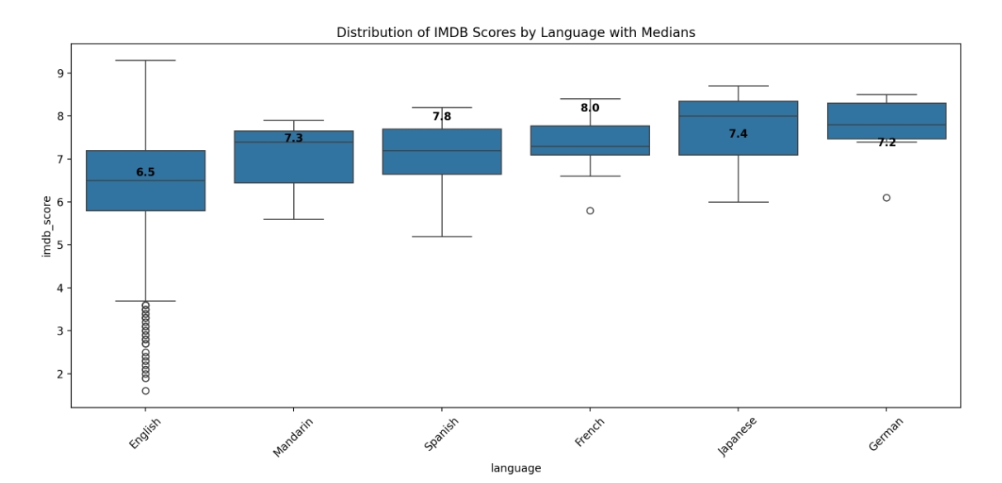

Slide 14
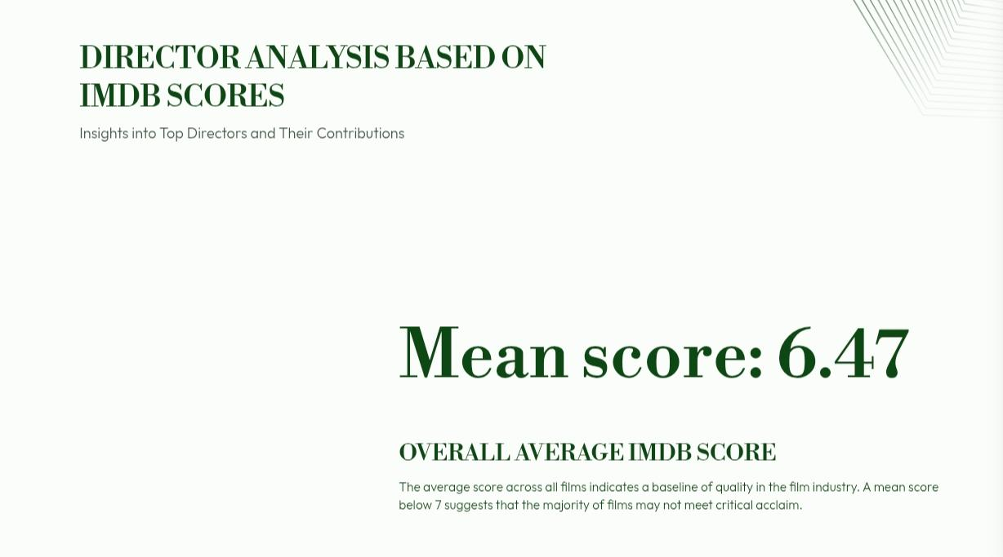

Slide 15
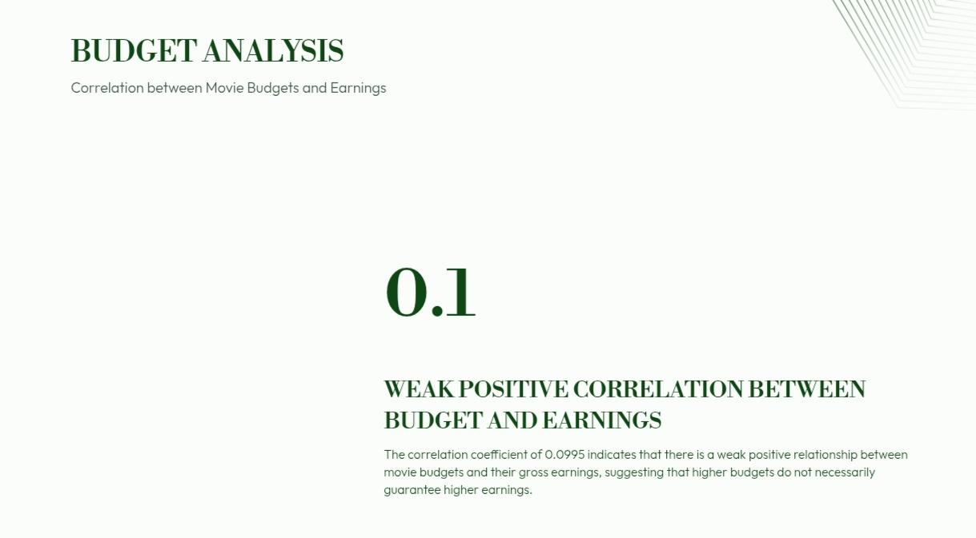

Slide 16
DETAILED INSIGHTS ON MOVIE TRENDS
In-Depth Analysis of Current Cinematic Trends and Influences
GENRE POPULARITY AND SUCCESS
Action, Drama, and Comedy have emerged as the most popular genres in contemporary cinema. While action films often attract larger audiences, they exhibit a wider range of ratings, reflecting varied reception among viewers.
DIRECTOR AND ACTOR INFLUENCE
Renowned directors like Christopher Nolan and Steven Spielberg have a track record of producing critically acclaimed films. Additionally, films featuring high-profile actors, such as Leonardo DiCaprio and Meryl Streep, tend to achieve higher ratings, showcasing the significant impact of star power on box office success.
BUDGET AND REVENUE CORRELATION
A positive correlation exists between a film's budget and its box office revenue, indicating that higher production costs can lead to greater financial returns. However, it is important to note that increased budgets do not always translate to better IMDb ratings, suggesting that audience satisfaction hinges on multiple factors beyond just financial investment.
LANGUAGE AND REGIONAL TRENDS
While English-language films dominate
the IMDb database, there is an observable rise in high-rated films from other languages, particularly Spanish and Korean. This trend highlights the growing appreciation for diverse cinematic storytelling across different cultures
DURATION AND RATINGS
Films that run between 90 to 120 minutes generally receive higher average ratings. In contrast, movies that are significantly longer or shorter often evoke mixed reviews, indicating that optimal film length is crucial for audience engagement and satisfaction.
MEANINGFUL TRENDS AND PATTERNS
The popularity of genres has shifted over the decades, with superhero and sci-fi films gaining significant traction in recent years. Furthermore, there is a noticeable trend towards more inclusive storytelling, as films that embrace diversity and address social issues are garnering critical acclaim
EVOLVING AUDIENCE PREFERENCES
As audience tastes evolve, there is an increasing appreciation for independent and foreign films. This shift underscores a broader cultural interest in varied narratives and perspectives, encouraging filmmakers to explore unique storytelling avenues.

